Slide 1
Mid-term Case Study
Research Question: How does covid-19 affect exchange rate
Hypothesis: The number of deaths caused by covid-19 and exchange rates are positively correlated.
NGO NGUYEN THANH THANG
20229549

Slide 2
Why I chose this topic
Modern Economy
Foreign exchange rate
Covid-19 effects
International trade is important:
Increases Economic Growth
Fosters Technological Advancement
Facilitates International Trade and Investment
Disruption of Global Supply Chains
Decline in Global Trade Volumes

Slide 3
Preliminary Research
Result 1
Challenge 2
Challenge 3
The real exchange rates were driven by the number of new Covid-19 deaths rather than by the number of new infections (Kohrt et al., 2022).
COVID-19 cases and deaths negatively affect the exchange rates of both countries in the short and long run (Li et al., 2021).
Foreign exchange market efficiency failed during the COVID period, indicating the pandemic was a destabilizing event for currency markets (Azzam et al., 2023).

Slide 4

A brief introduction about exchange rate
An exchange rate is the value of one currency expressed in terms of another currency. It determines how much of one currency you can get in exchange for another. Exchange rates play a crucial role in international trade, investment, and financial markets by allowing countries, businesses, and individuals to trade goods, services, and assets across borders.
5

Slide 5
The higher the base/quote ratio is the weaker the quote currency become when comparing with the base currency.

Slide 6
Base Currency
EUR
Quote currency
Quote Currency
Quote Currency
USD
CNY
JPY
2020-06-01
2020-06-30
2021-06-01
2021-06-30
2022-06-01
2022-06-30
2023-01-01
2023-01-30

Slide 7
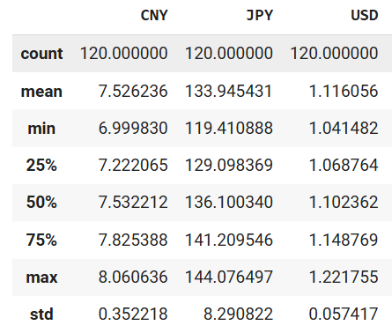
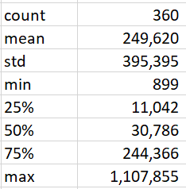
Basic Statistics
Currency exchange rates
Deaths caused by covid-19

Slide 8
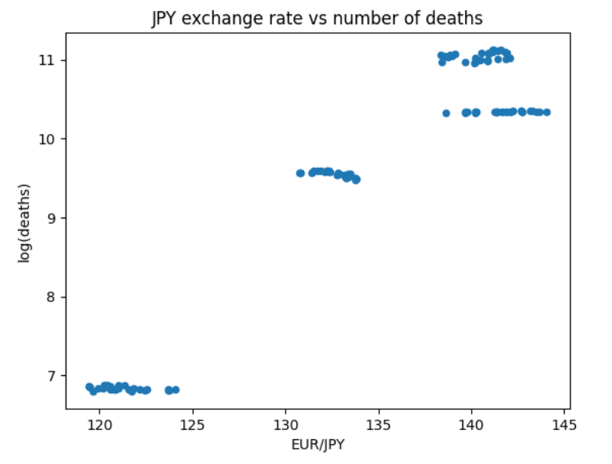
Japan
Correlation check
Scatter plot
Pearson’s Correlation coefficient
Pearson's Correlation Coefficient: 0.95
P-value: 1.8e-65
There is a strong positive correlation between the JPY and the number of covid-19 deaths

Slide 9
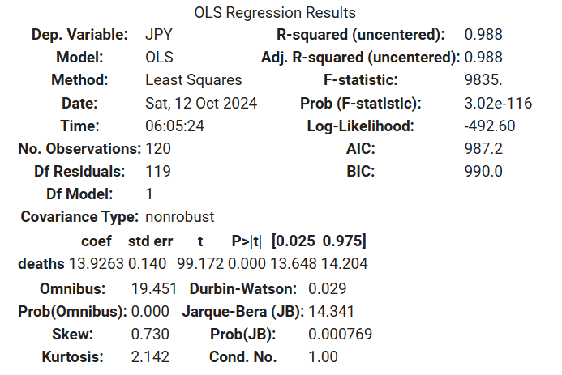
Japan
Linear Regression Model
The regression model shows there is a strong positive relationship between the number of deaths caused by covid-19 in Japan and the Japanese currency exchange rates. Since the P value is significant (<0.05) we could say that on average if log of covid-19 deaths increase by 1 unit, then the Chinese currency exchange rates would increase by 13.9 units. In other words, the Japanese currency would become weaker compared to Euro. In addition, the adjusted R-squared statistics is very high (0.98). This suggest that the number of covid-19 deaths has a strong overall effect on exchange rate.

Slide 10
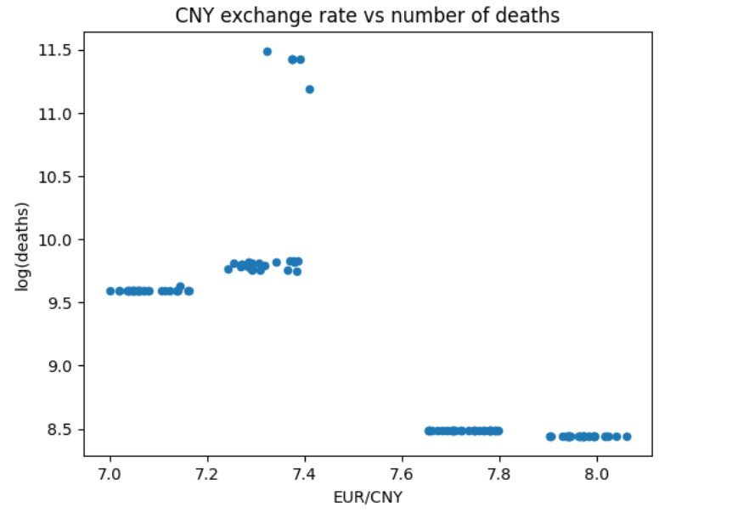
China
Correlation check
Scatter plot
Pearson’s Correlation coefficient
Pearson's Correlation Coefficient: -0.75
P-value: 5.6e-23
There is negative correlation between the CNY currency and the number of covid-19 deaths

Slide 11
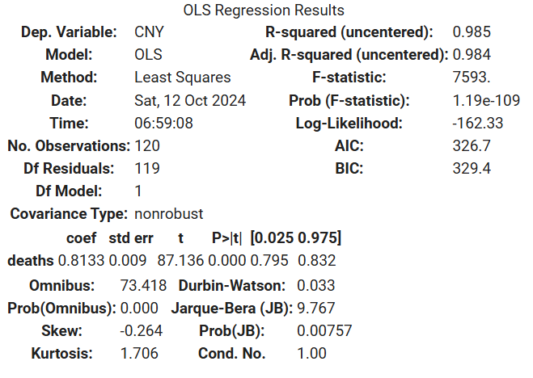
China
Linear Regression Model
The regression model suggests there is a positive relationship between the number of deaths caused by covid-19 in China and the Chinese currency exchange rates. Since the P value is significant (<0.05) we could say that on average if log of covid-19 deaths increase by 1 unit, then the Chinese currency exchange rates would increase by 0.8 unit. In other words, the Chinese currency would become weaker compared to Euro. In addition, the adjusted R-squared statistics is very high (0.98). This suggest that the number of covid-19 deaths has a strong overall effect on exchange rate.

Slide 12
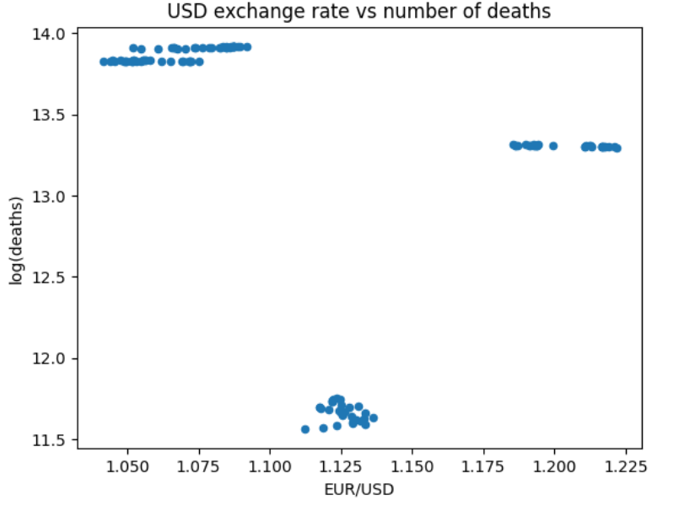
USA
Correlation check
Scatter plot
Pearson’s Correlation coefficient
Pearson's Correlation Coefficient: -0.33
P-value: 0.0001
There is negative correlation between the USD currency and the number of covid-19 deaths

Slide 13
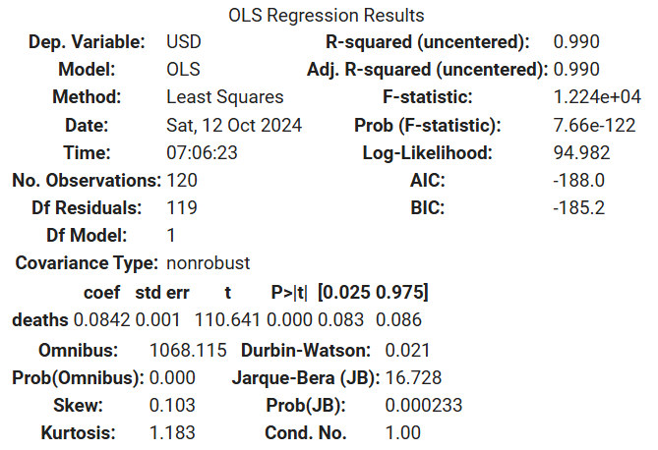
USA
Linear Regression Model
The regression model shows there is a weak positive relationship between the number of deaths caused by covid-19 in America and the American currency exchange rates. Since the P value is significant (<0.05) we could say that on average if log of covid-19 deaths increase by 1 unit, then the American currency exchange rates would increase by 0.08 unit. In other words, the American currency would become weaker compared to Euro. In addition, the adjusted R-squared statistics is very high (0.99). This suggest that the number of covid-19 deaths has a strong overall effect on exchange rate.

Slide 14
In Summary
1. The analysis produced mixed results.
2. While all the linear regression model suggest that there is a positive relationship between a country's currency and the number of covid-19 deaths, only Japan's Pearson's coefficient yields a positive relationship. By contrast, America and China's Pearson's coefficient suggest there is a negative relationship between the 2 variables.
3. As all the R-squared are > 0.9, this suggest that linear regresson is a good model to capture the relationship between the number of covid-19 deaths and exchange rates. This makes it difficult to choose between the Pearson's coefficient and the linear regression coefficient.

Slide 15
Conclusion
As the analysis produced mixed-results, I decided to reject the hypothesis that there is a positive correlation between the number of deaths caused by covid-19 and exchange rates.

Slide 16
References
Azzam, I., El-Masry, A. A., & Yamani, E. (2023). Foreign exchange market efficiency during COVID-19 pandemic. International Review of Economics & Finance, 86, 717–730. https://doi.org/10.1016/j.iref.2023.03.043
Kohrt, L., Horky, F., & Fidrmuc, J. (2022). Exchange rates in emerging markets in the first wave of the COVID-19 pandemic. Eastern European Economics, 62(2), 165–186. https://doi.org/10.1080/00128775.2022.2074461
Li, C., Su, Z., Yaqoob, T., & Sajid, Y. (2021). COVID-19 and currency market: a comparative analysis of exchange rate movement in China and USA during pandemic. Economic Research-Ekonomska Istraživanja, 35(1), 2477–2492. https://doi.org/10.1080/1331677x.2021.1959368

